Slide 1

STATS 432 Computational Statistics
Chapter 9 – Metropolis Hastings Algorithm
Additional Slides

Slide 2

Overview of the Metropolis Hastings Algorithm

Slide 3


Overview of MH Algorithm:
Overview of MH Algorithm
Consider the random variable $X$ defined by the probability density function…
$$f_{X}(x) = \left\{\begin{matrix}A x e^{−x} & if x∈[0,100] \\ 0 & otherwise\end{matrix}\right.$$
$$A=\left(1 −101e^{−100}\right) ≈1$$
is a normalizing constant
… and the function $g\left(x\right)=\frac{\ln\left(x+2\right)}{\cos{(√x})+1}$
Suppose that we want to evaluate the integral
$$E_{f}\left[ g\left(X\right) \right] ≡ \int_{Ω}{g\left(x\right) f_{X}\left(x\right) dx} = \int_{0}^{100}{\frac{\ln\left(x+2\right)}{\cos{(\sqrt{x}})+1} A x e^{−x}dx}$$
This integral is intractable (too hard to be solved analytically). However, from the Ergodic Theorem, we know we can approximate this integral by taking a large number of observations of $X$ distributed according to $f_{X}(x)$and calculating
$${\overline{g}}_{n}\left(X\right)≡ \frac{1}{n} \sum_{i=1}^{n}{g\left(X_{i}\right)}$$
In order to produce a large number of observations of $X$ distributed according to $f_{X}\left(x\right)$, we can use the Metropolis-Hastings algorithm which works as follows…
3

Slide 4
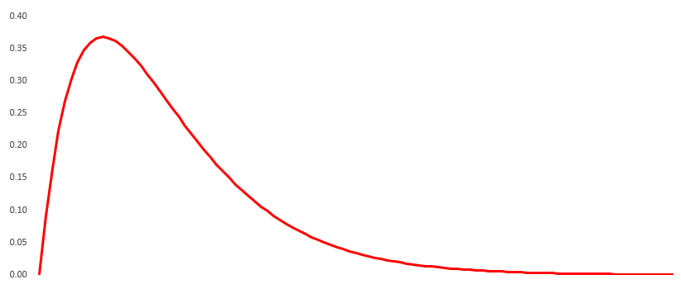














Overview of MH Algorithm
$f_{X}\left(x\right)$
$$X^{(0)}$$
✓
$$y$$
✗
$$X^{(1)}$$
$$y$$
✓
$$y$$
$$X^{(2)}$$
✓
$$y$$
$$X^{(3)}$$
✗
$$X^{(4)}$$
$$y$$
✓
$$y$$
$$X^{(5)}$$
$$X^{(6)}$$
4

Slide 5
Overview of MH Algorithm
$f_{X}\left(x\right)$
Although the first few observations (the burn-in) may not fit the desired pattern,
if we keep repeating this process over and over again, we will obtain a sequence of observations distributed according to the target distribution $f_{X}\left(x\right).$
5

Slide 6
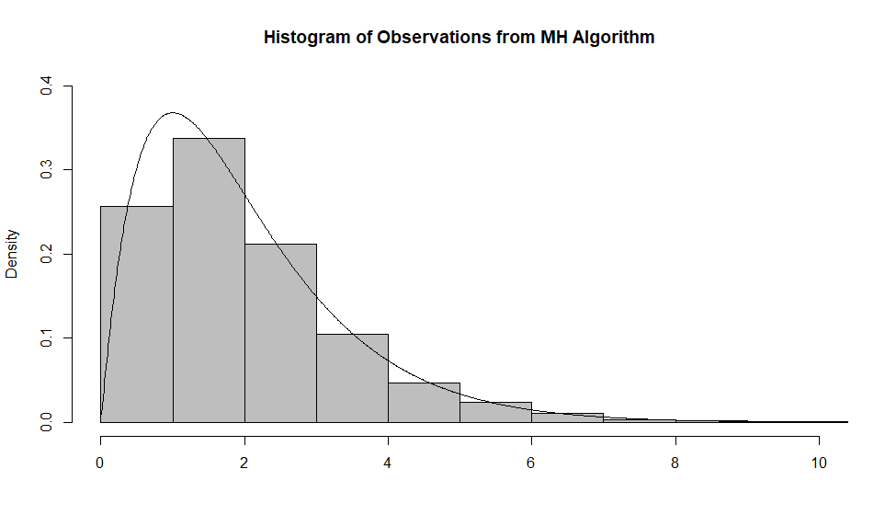
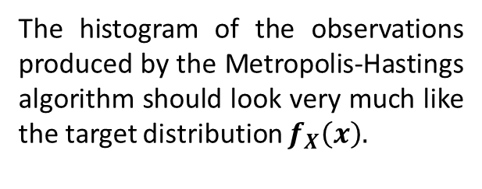
Overview of MH Algorithm:
Overview of MH Algorithm
The histogram of the observations produced by the Metropolis-Hastings algorithm should look very much like the target distribution $f_{X}\left(x\right).$
6

Slide 7

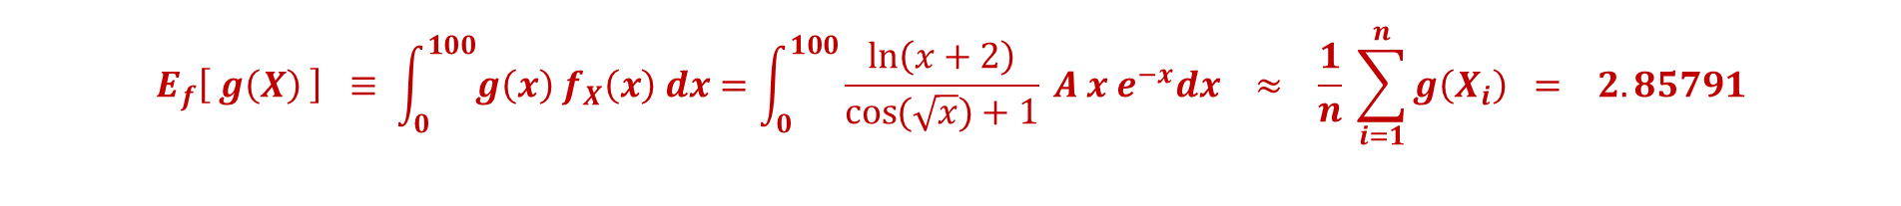
Overview of MH Algorithm:
Overview of MH Algorithm
Consider the random variable $X$ defined by the probability density function…
$$f_{X}(x) = \left\{\begin{matrix}A x e^{−x} & if x∈[0,100] \\ 0 & otherwise\end{matrix}\right.$$
$$A=\left(1 −101e^{−100}\right) ≈1$$
is a normalizing constant
… and the function $g\left(x\right)=\frac{\ln\left(x+2\right)}{\cos{(√x})+1}$
Suppose that we want to evaluate the integral
$$E_{f}\left[ g\left(X\right) \right] ≡ \int_{0}^{100}{g\left(x\right) f_{X}\left(x\right) dx}=\int_{0}^{100}{\frac{\ln\left(x+2\right)}{\cos{(\sqrt{x}})+1} A x e^{−x}dx}$$
This integral is intractable (too hard to be solved analytically). However, we know we can approximate this integral by taking a large number of observations of $X$ distributed according to $f_{X}(x)$and calculating
$${\overline{g}}_{n}\left(X\right)≡ \frac{1}{n} \sum_{i=1}^{n}{g\left(X_{i}\right)}$$
$$E_{f}\left[ g\left(X\right) \right] ≡ \int_{0}^{100}{g\left(x\right) f_{X}\left(x\right) dx}=\int_{0}^{100}{\frac{\ln\left(x+2\right)}{\cos{(\sqrt{x}})+1} A x e^{−x}dx} ≈ \frac{1}{n} \sum_{i=1}^{n}{g\left(X_{i}\right)} = 2.85791$$
7

Slide 8
Choice of Proposal Denisty

Slide 9
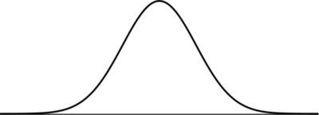

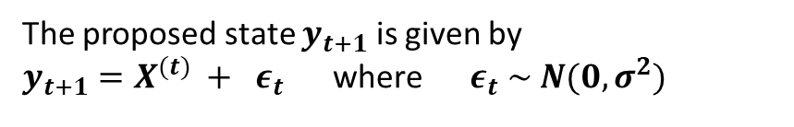


Normal Random Walk Sampler:
Choice of Proposal Density
Suppose that the chain is in state $X^{(t)}$
The proposed state $y_{t+1}$ is given by
$y_{t+1}=X^{(t)} + ε_{t}$ where $ε_{t} \sim N(0, σ^{2})$
$f_{X}\left(x\right)$
$$X^{(t)}$$
9

Slide 10

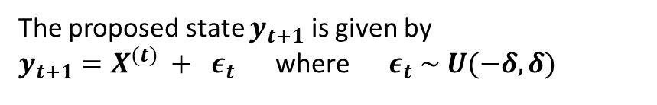

Uniform Random Walk Sampler:
Choice of Proposal Density
Suppose that the chain is in state $X^{(t)}$
The proposed state $y_{t+1}$ is given by
$y_{t+1}=X^{(t)} + ε_{t}$ where $ε_{t} \sim U(−δ,δ)$
$$X^{(t)}−δ$$
$$X^{(t)}+δ$$
$f_{X}\left(x\right)$
$$X^{(t)}$$
10

Slide 11
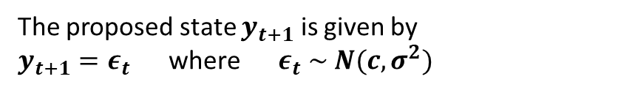
Normal Independence Sampler:
Choice of Proposal Density
Suppose that the chain is in state $X^{(t)}$
The proposed state $y_{t+1}$ is given by
$y_{t+1}=ε_{t}$ where $ε_{t} \sim N(c, σ^{2})$
$f_{X}\left(x\right)$
c
$$X^{(t)}$$
11

Slide 12
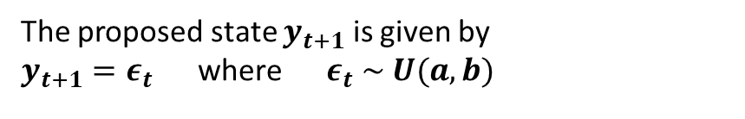
Uniform Independence Sampler:
Choice of Proposal Density
Suppose that the chain is in state $X^{(t)}$
The proposed state $y_{t+1}$ is given by
$y_{t+1}=ε_{t}$ where $ε_{t} \sim U(a,b)$
$f_{X}\left(x\right)$
$$X^{(t)}$$
12

Slide 13
Width / SD of Proposal Density

Slide 14
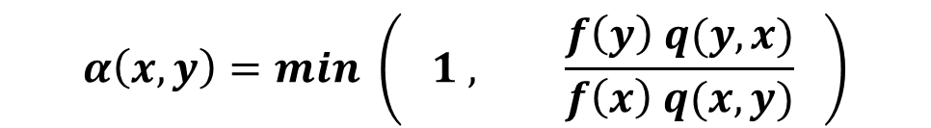
Width / SD of Proposal Density:
Width / SD of Proposal Density
$$α\left(x,y\right)=min \left( 1 , \frac{f\left(y\right) q(y,x)}{f\left(x\right) q(x,y)} \right)$$
Smaller changes are more likely to be accepted, but mean that the chain is more likely to mix slowly.
Larger changes are less likely to be accepted, but mean that the chain will exhibit less auto-correlation when it does move. However, if acceptance rate is too low, the chain will remain stationary for large periods of time also leading to slow mixing.
Need to tune the width / standard deviation of the proposal density so that the chain traverses the support of the target distribution quickly (i.e. so that the chain mixes well).
14

